Slide 1
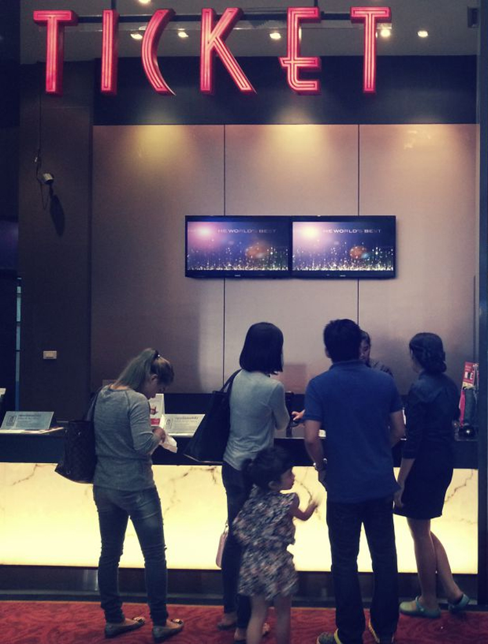
“MOVIE TICKET BOOKING
SYSTEM"
Presented by,
MD ZIHAD
ID: 0112330577
SHOHAN
ID: 0112330605

Slide 2

TABLE OF CONTENTS:
This simple program will make the Ticket Booking system ease. The program has 5 main functions:
Login
Add Movie
View Movie List
Book Tickets
Generate Bill

Slide 3
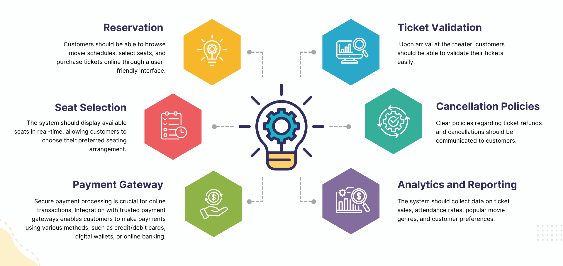
Key Points

Slide 4
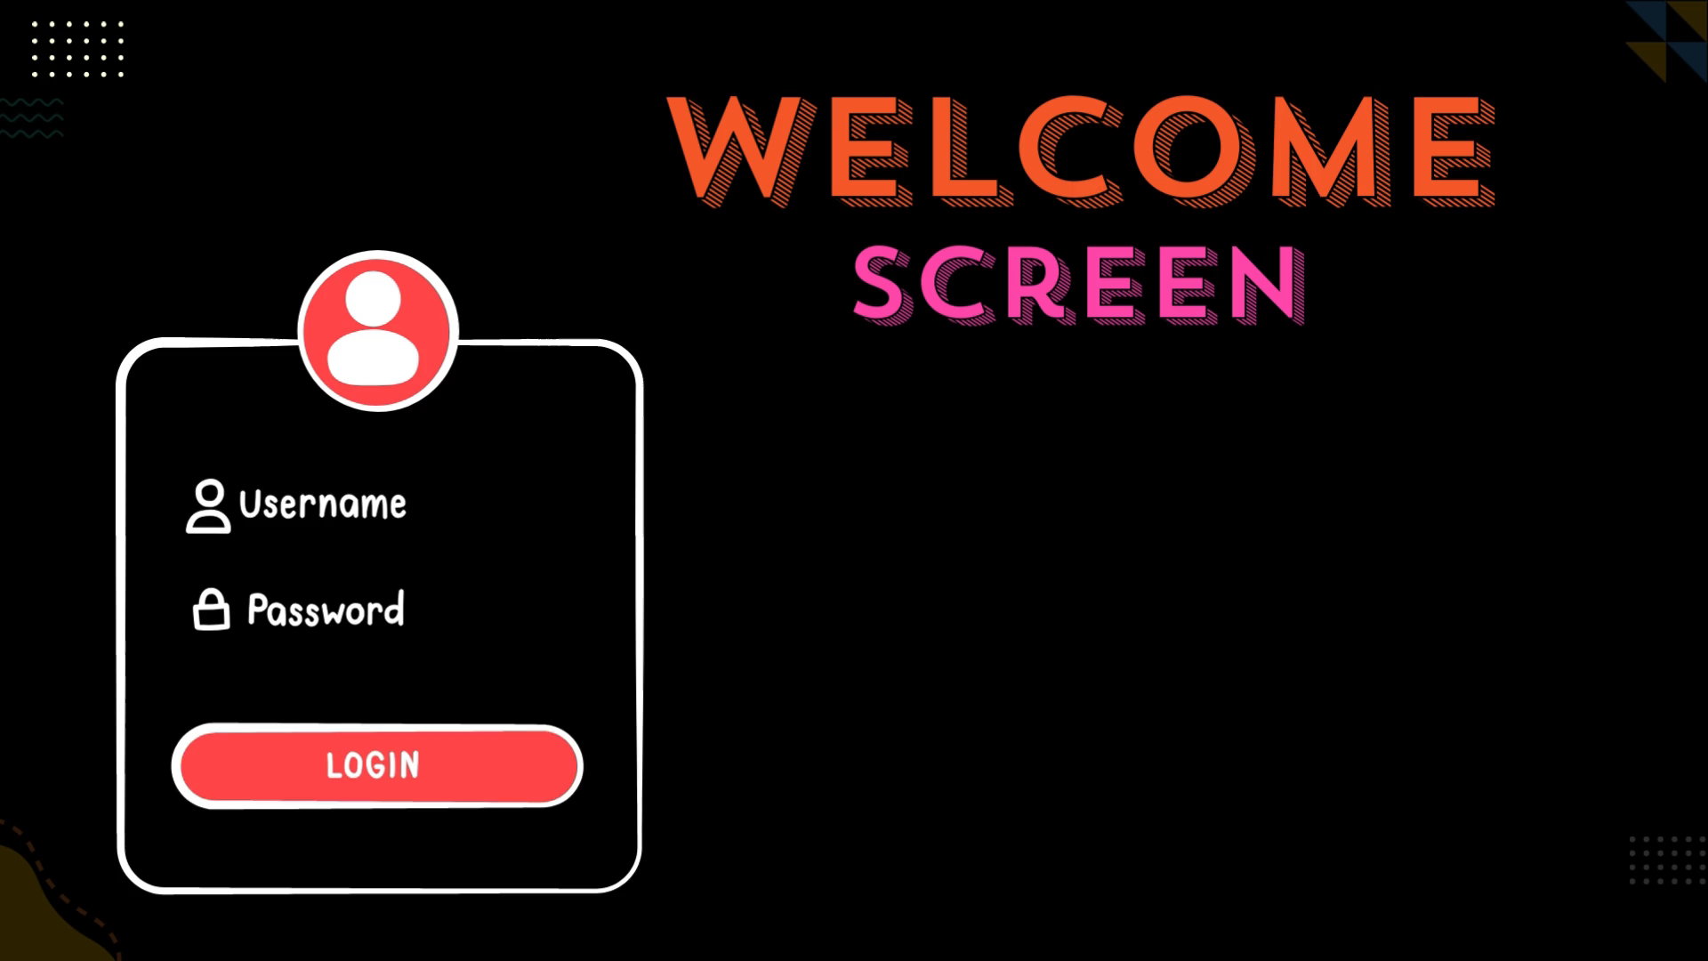


Slide 5
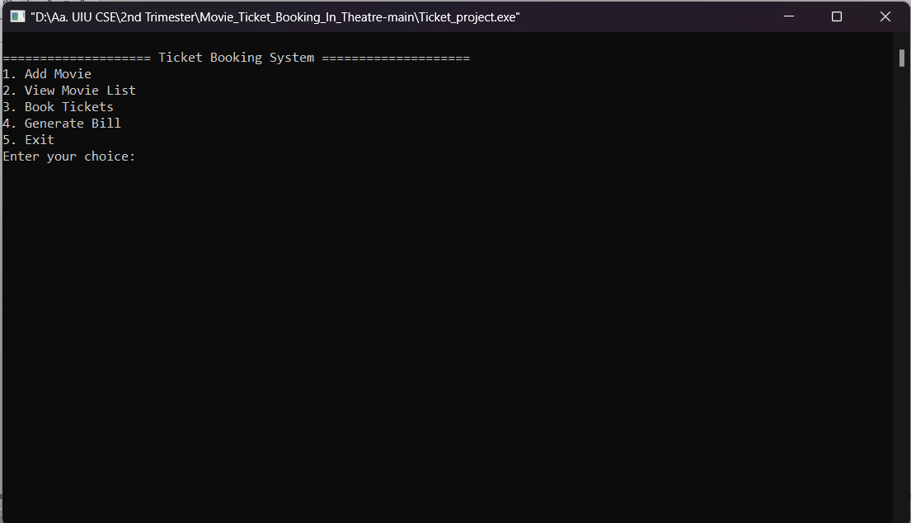
Main interface

Slide 6
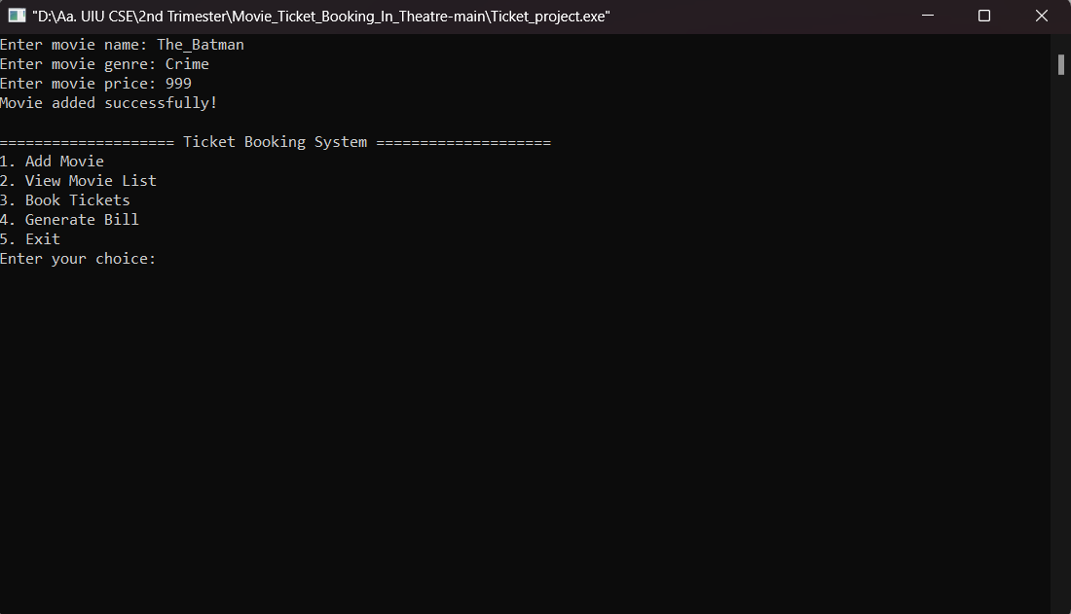
Movie Added in the List

Slide 7
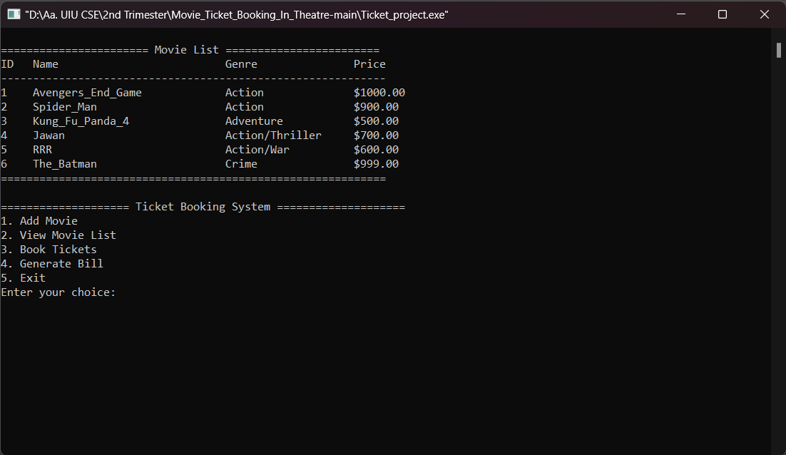
View Movie List

Slide 8
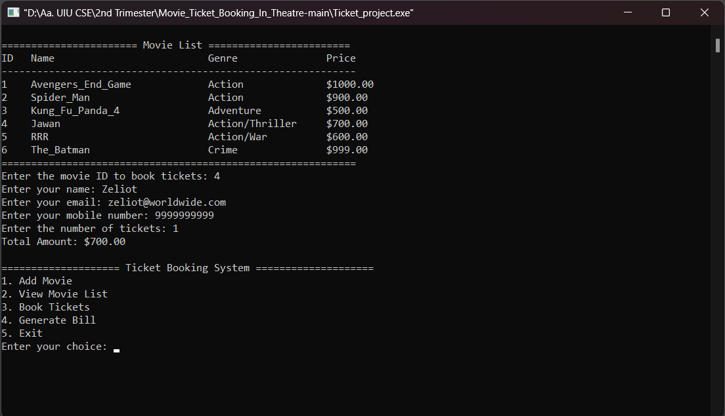
Book Ticket

Slide 9
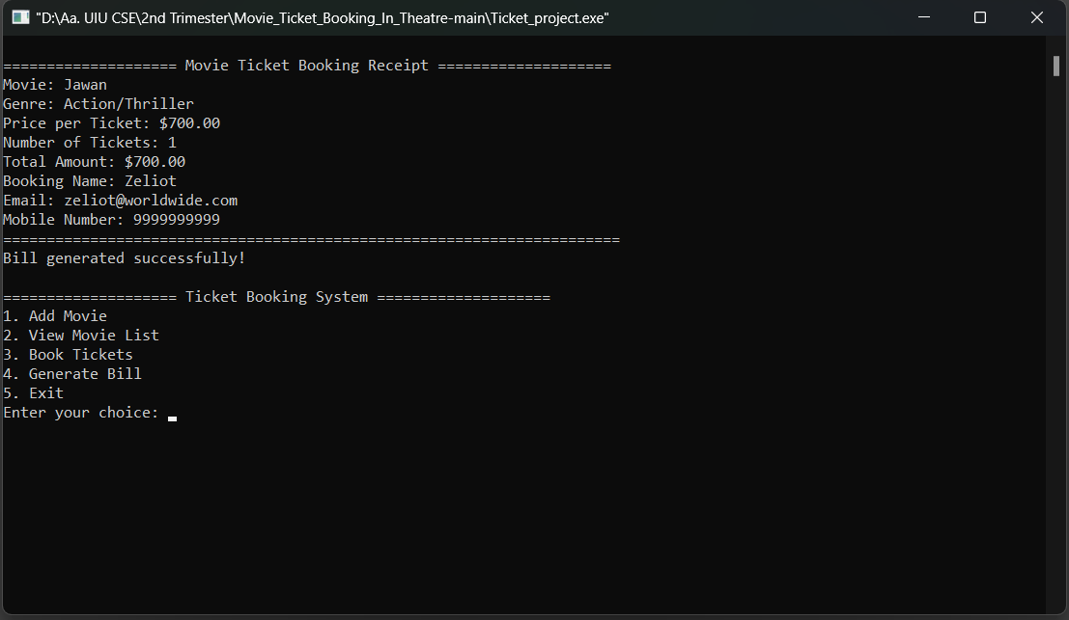
Generate Bill

Slide 10


